Slide 2
School Demographics
548 Students
66 Staff Members
48% F&R
Classroom Counts
Kinder 104
1st 81
2nd 80
3rd 86
4th 100
5th 97
98 Students served by LAP
68 Students on IEP
548 Schoolwide Title 1 Program
106 Students served by Title 1

Slide 3
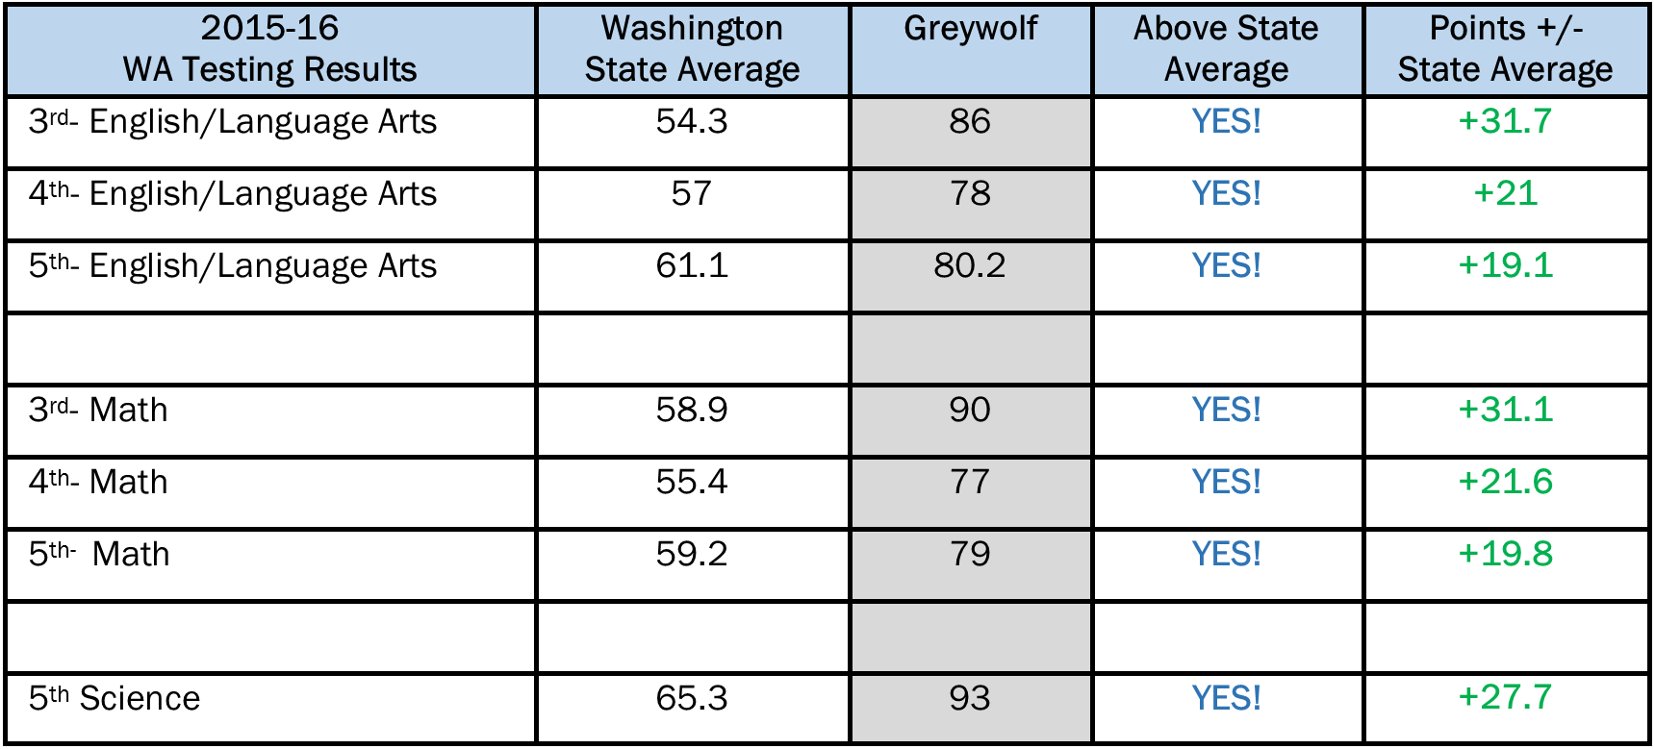
SBA 2015-16 Scores

Slide 4
Peninsula SBA Comparison 2016
3rd Grade
4th Grade
5th Grade
School | F&R | ELA | Rank | Math | Rank
Greywolf | 47.40% | 86% | 1 | 90 | 1
Hamilton | 53.30% | 82% | 2 | 84 | 2
Roosevelt | 48.40% | 75.90% | 3 | 75.9 | 3
Helen Haller | 57% | 74.40% | 4 | 74.7 | 4
Dry Creek | 68.30% | 66% | 5 | 63 | 6
Forks | 68.60% | 45.20% | 7 | 63.5 | 5
Washington | 44% | 54.30% | 6 | 58.9 | 7
Chimacum | 48.10% | 36.30% | 8 | 35.3 | 9
Quilcene | 47.80% | 26.30% | 10 | 36.8 | 8
Franklin | 57.50% | 34.60% | 9 | 30.7 | 10
Grant Street | 55.50% | Suppressed |  | Suppressed
Jefferson | 62.50% | Suppressed |  | Suppressed
School | F&R | ELA | Rank | Math | Rank
Greywolf | 47.40% | 78% | 1 | 77% | 1
Hamilton | 53.30% | 68.80% | 2 | 69.50% | 2
Helen Haller | 57% | 63.70% | 3 | 58.80% | 3
Washington | 44% | 57% | 5 | 55.40% | 4
Roosevelt | 48.40% | 58.60% | 4 | 55.10% | 5
Franklin | 57.50% | 53.40% | 6 | 48.80% | 7
Dry Creek | 68.30% | 51% | 7 | 49.00% | 6
Chimacum | 48.10% | 45.40% | 8 | 35.50% | 8
Quilcene | 47.80% | 38.40% | 9 | 23% | 9
Jefferson | 62.50% | Suppressed |  | Suppressed
Grant Street | 55.50% | Suppressed |  | Suppressed
Forks | 68.60% | Suppressed |  | Suppressed
School | F&R | ELA | Rank | Math | Rank
Greywolf | 47.40% | 80.20% | 1 | 79% | 1
Franklin | 57.50% | 66.60% | 3 | 59.20% | 3
Helen Haller | 57% | 60.80% | 6 | 63.90% | 2
Roosevelt | 48.40% | 61.10% | 5 | 51.80% | 4
Chimacum | 48.10% | 62.10% | 4 | 44.50% | 7
Washington | 44% | 60.10% | 7 | 49.20% | 5
Dry Creek | 68.30% | 50.90% | 8 | 30.10% | 8
Quilcene | 47.80% | 23% | 9 | 7.60% | 9
Hamilton | 53.30% | 68.80% | 2 | Suppressed
Jefferson | 6.50% | Suppressed |  | 48.80% | 6
Grant Street | 55.50% | Suppressed |  | Suppressed
Forks | 68.60% | Suppressed |  | Suppressed

Slide 5
STUDENTS Passing SBA ELA
3rd Grade (89 kids)
76/13=86%
10 out of 13 SWD Passed
4th Grade (89 kids)
70/19=78%
15 out of 19 SWD Passed
5th Grade
(81 kids)
66/15=87%
6 out of 8 SWD Passed

Slide 6
STUDENTS Passing SBA Math
3rd Grade (89 kids)
80/9=90%
11 out of 13 SWD Passed
4th Grade (89 kids)
69/20=77%
15 out of 19 SWD Passed
5th Grade
(81 kids)
64/17=79%
6 out of 8 SWD Passed

Slide 7
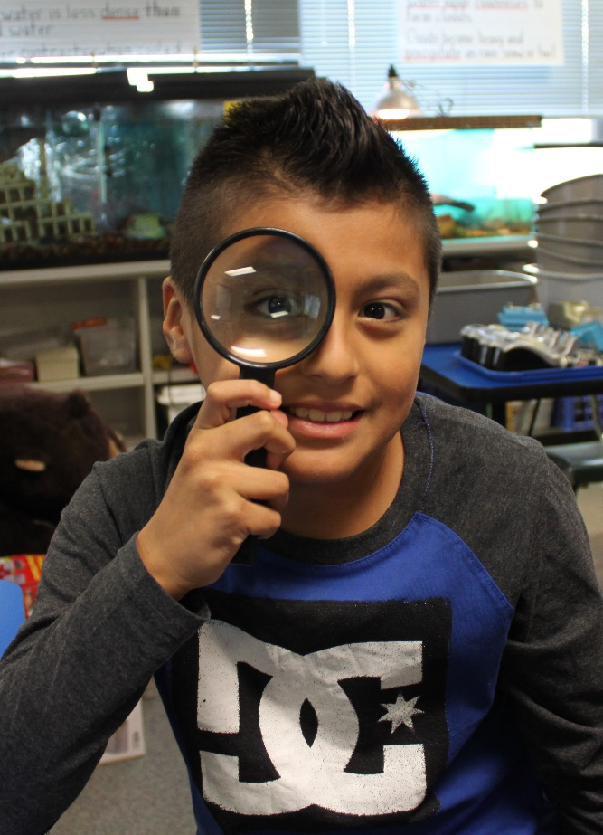
STUDENTS Passing MSP Science
5th Grade Science Students
(81 kids) 75/6=93%
7 out of 8 SWD Passed

Slide 8
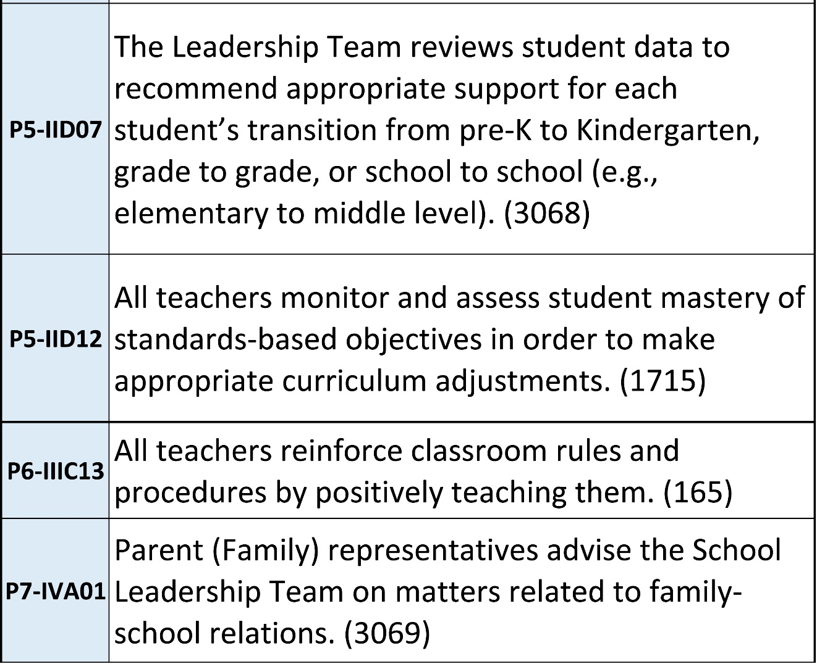
Greywolf 2015-2016 SIP
SIP Areas of Concentration

Slide 9
This year’s SIP three areas of concentration:
Teacher Data
Teaching
⬥ Parent & Family Involvement

Slide 10
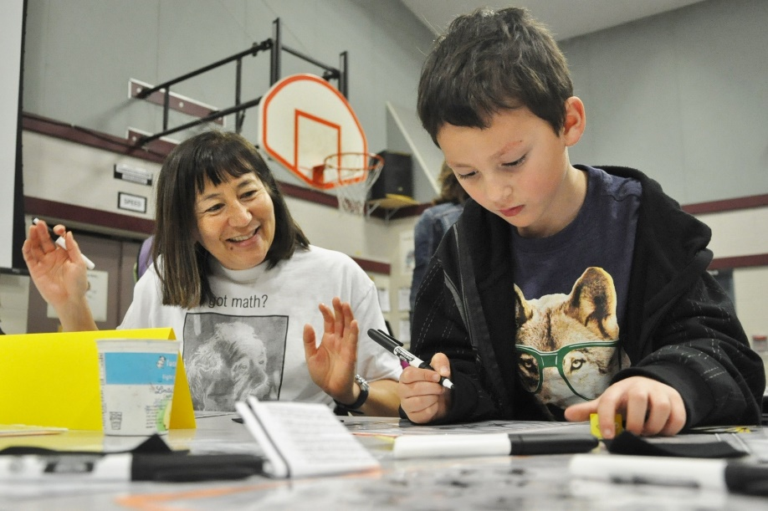
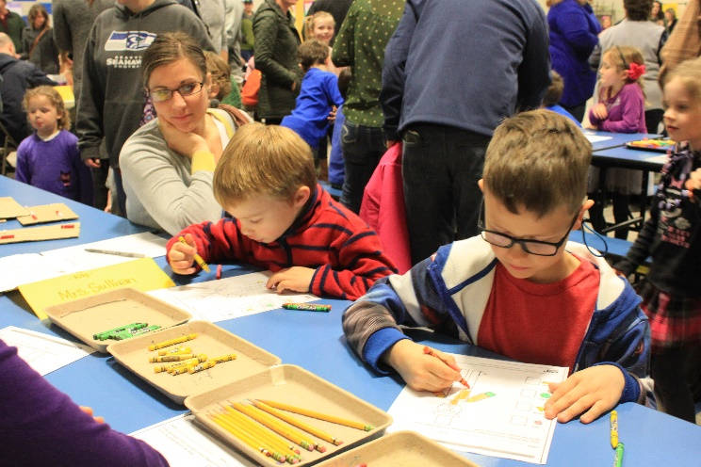
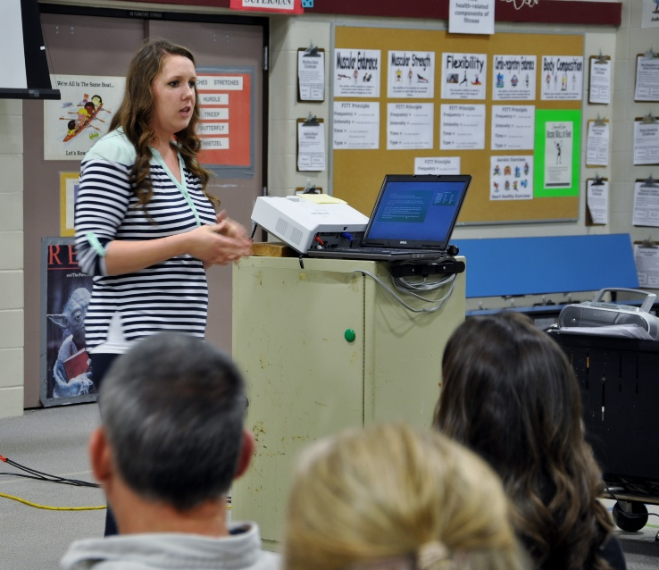
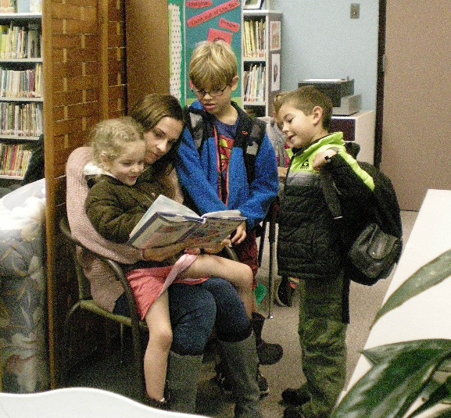
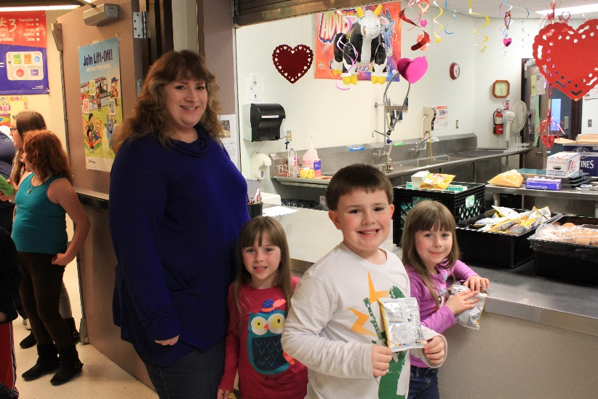
Family Engagement
Family Engagement Nights
Family Math Night & Free Dinner
Early Bird Reader
Family Movie Night

Slide 11
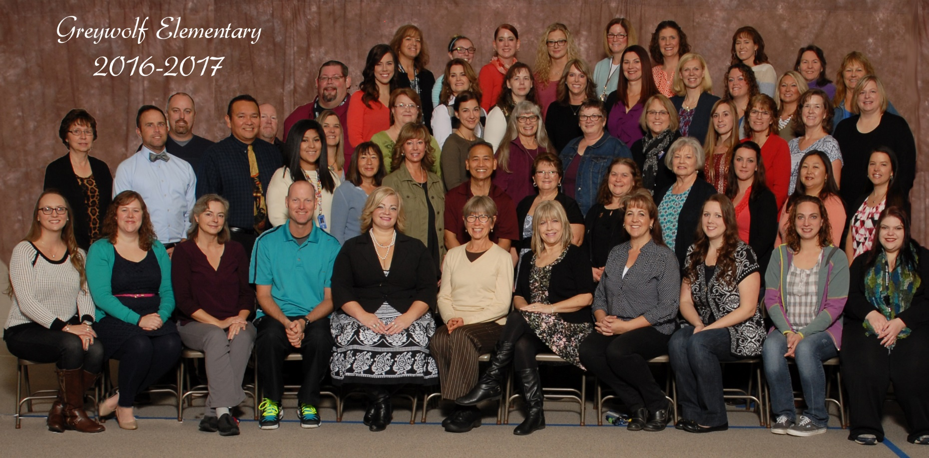
Thank You for Inviting Us!

